Slide 1

Hands-On Knowledge Mapping in R
(library Bibliometrix )
Cognitive Maps: Encoding and Decoding Information
Mathew Fletcher
https://www.library.qut.edu.au/about/contact/staff/m_fletcher.jsp
Dr Quentin Pope
https://www.library.qut.edu.au/about/contact/staff/q_pope.jsp

Slide 2
The intention of these minutes :
Brief Overview of Literature mapping
Examples of Literature mapping
A practical introduction to the R Package – bibliometrix [biblioshiny: user-friendly extension of the Bibliometrix Package] as a literature mapping tool
Live demonstration
Data retrieval/preparation
Document clustering
Visualising networks
Authors’ scientific productivity
Documents’ graphical representations incl. Reference spectrography
Conceptual structures’ analysis incl. Factorial analysis
Intellectual structures incl. Thematic maps
and more
Aria, M., & Cuccurullo, C. (2017). bibliometrix: An R-tool for comprehensive science mapping analysis. Journal of informetrics, 11(4), 959-975
Bibliometrix download: https://www.bibliometrix.org/home/index.php/download

Slide 3
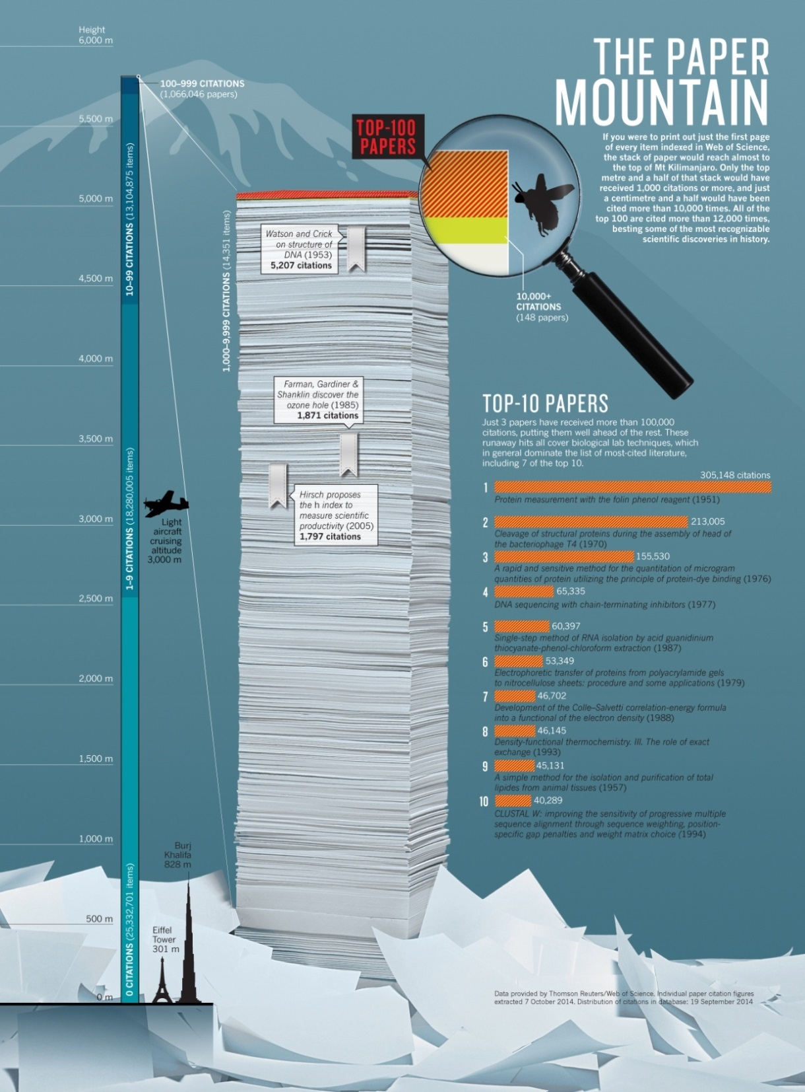
http://www.nature.com/news/the-top-100-papers-1.16224

Slide 4
“The map is not the territory”? Alfred Korzybski And yet, a good design is an essential step
A map is not the territory it represents, but, if correct, it has a similar structure to the territory, which accounts for its usefulness.
— Alfred Korzybski, Science and Sanity (1933, p. 58)
Maps are not only passive representation of the reality (the critical analysis in the case of literature research)
Maps are tools for the production of meaning (portals of discovery)
Subjects who learned the city from studying a cartographic map were significantly more accurate and faster at performing the simple experimental task of locating familiar landmarks relative to reference points than subjects who learned the city through direct experience or navigation
Lloyd, R. (1989). Cognitive Maps: Encoding and Decoding Information, Annals of the Association of American Geographers, 79:1, 101-124, DOI: 10.1111/j.1467-8306.1989.tb00253.x

Slide 5
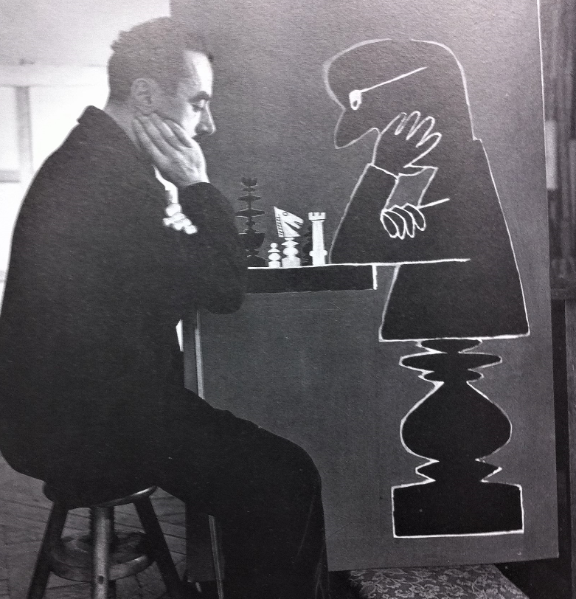
Starting Points
Everything has been said yet few have taken advantage of it. Since all our knowledge is essentially banal, it can only be of value to minds that are not.
― Raoul Vaneigem, The Revolution of Everyday Life
Suffering is the pain of constraints. An atom of pure delight, no matter how small, can hold it at bay. ― Raoul Vaneigem, The Revolution of Everyday Life
One never reaches a point of shapedness or finishedness
― John Cage, The Roaring Silence: John Cage: A Life by David Revill

Slide 6
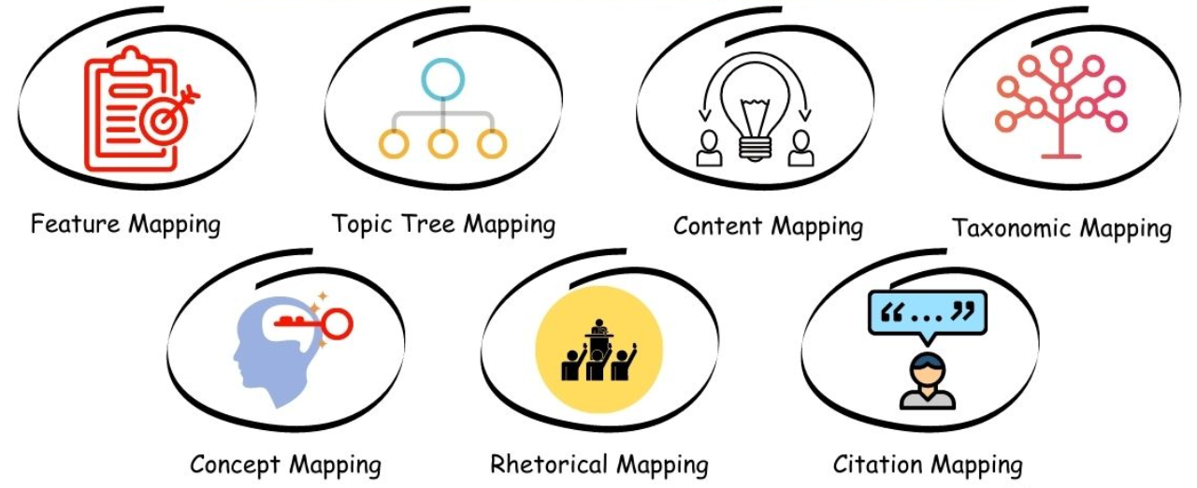
Literature mapping methods
Example: https://www.enago.com/academy/literature-mapping-5-most-recommended-tools-to-use/

Slide 7
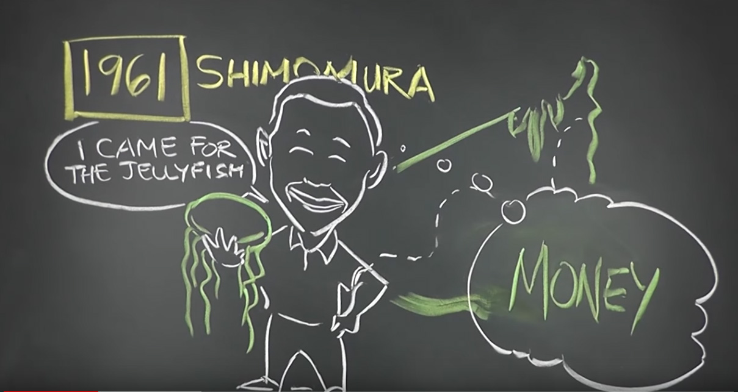
Jellyfish!
https://youtu.be/8vu68c4Rf6A

Slide 8
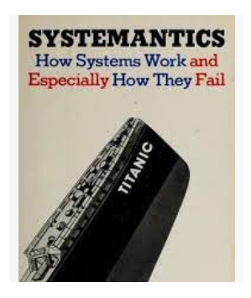
Data vs Capta [Facts and Figures]
“Some significant progress is being made in visualizing uncertainty in data models for GIS, decision-making, archaeological research and other domains. But an important distinction needs to be clear from the outset: the task of representing ambiguity and uncertainty has to be distinguished from a second task – that of using ambiguity and uncertainty as the basis on which a representation is constructed. This is the difference between putting many kinds of points on a map to show degrees of certainty by shades of color, degrees of crispness, transparency etc., and creating a map whose basic coordinate grid is constructed as an effect of these ambiguities. In the first instance, we have a standard map with a nuanced symbol set. In the second, we create a non-standard map that expresses the constructed-ness of space. Both rely on rethinking our approach to visualization and the assumptions that underpin it.”
Drucker, J. (2011). Humanities approaches to graphical display. Digital Humanities Quarterly, 5(1), 1-21

Slide 9
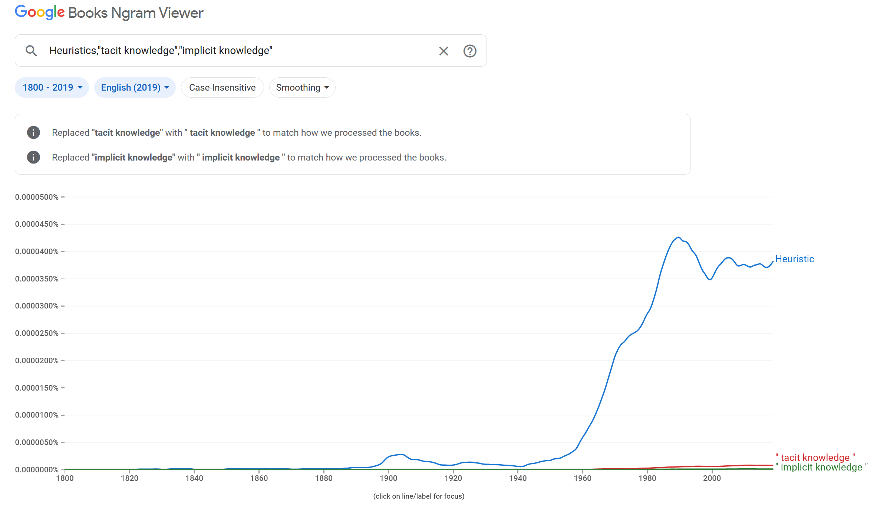
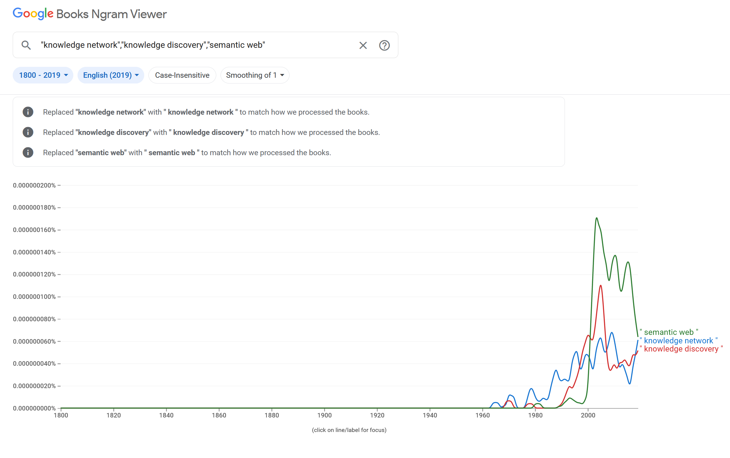
Further example: Books Ngram Viewer
What does the Ngram Viewer do?
When you enter phrases into the Google Books Ngram Viewer, it displays a graph showing how those phrases have occurred in a corpus of books (e.g., "British English", "English Fiction", "French") over the selected years.

Slide 10
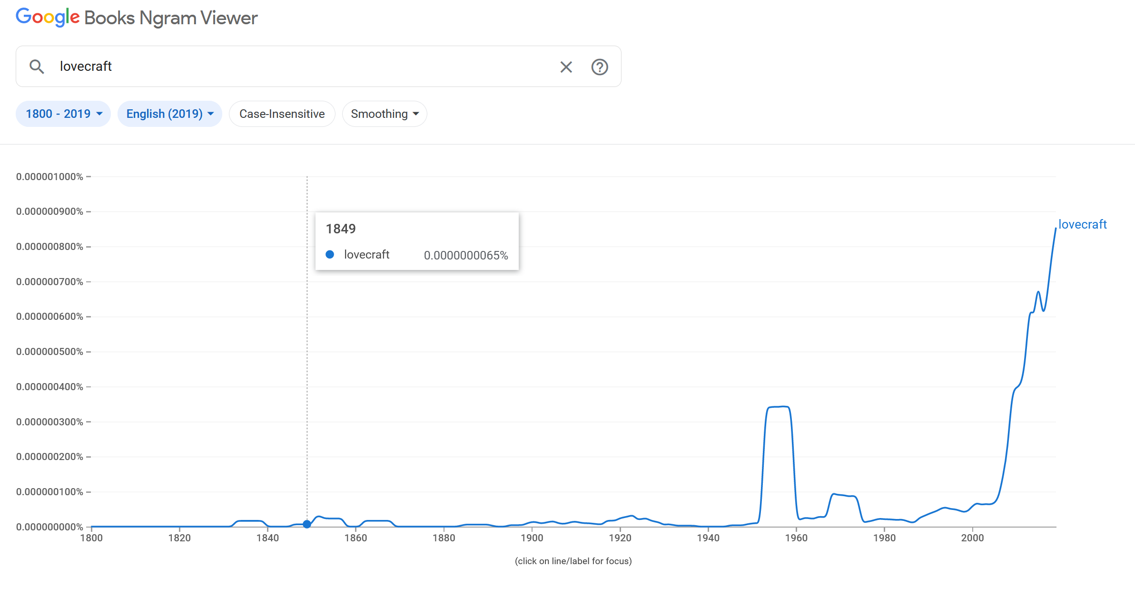
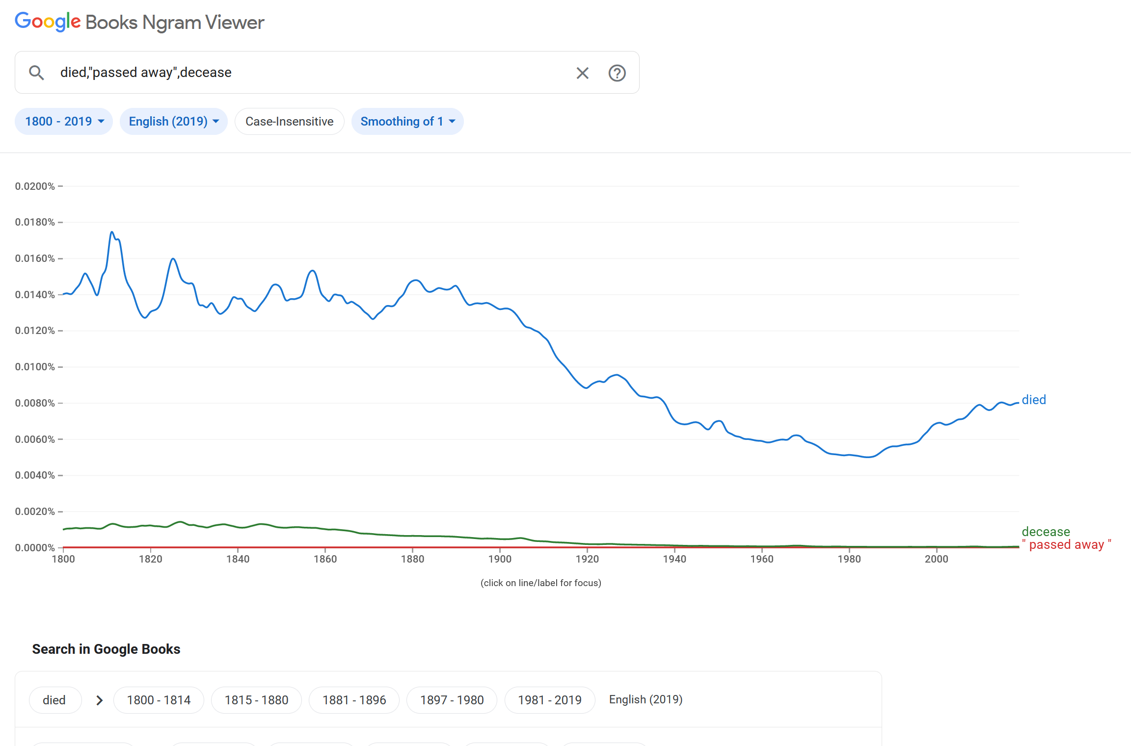
Further example: Books Ngram Viewer

Slide 11
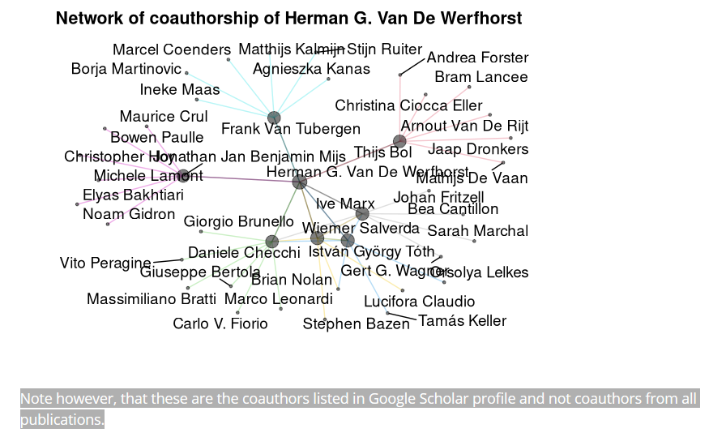
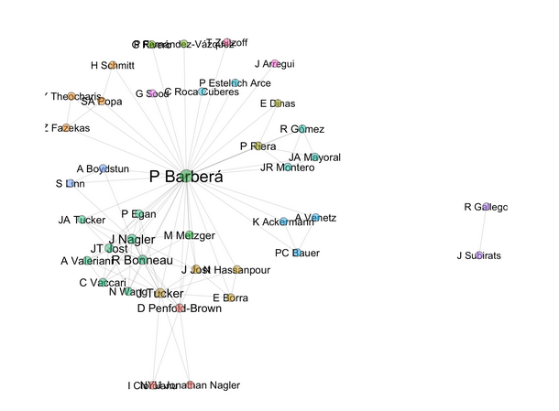
Analyse citation data from Google Scholar (examples of existing packages)
https://cran.r-project.org/web/packages/scholar/vignettes/scholar.html
https://github.com/pablobarbera/scholarnetwork

Slide 12
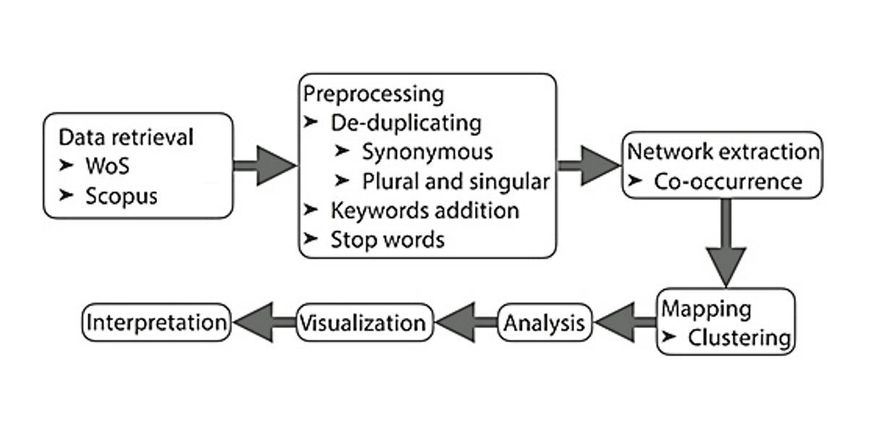
Live Demonstration: A brief diagram of the workflow of the analysis performed today

Slide 13
Networks displayed in bibliometrix: Enabling cross-walks Portals of discovery
Words
Documents
Concepts
Authors
Social structures
Themes
Intellectual
structures

Slide 14
Selected References
Bibliometrix download: https://www.bibliometrix.org/home/index.php/download
Peng, R. D. (2016). R programming for data science (pp. 86-181). Victoria, BC, Canada: Leanpub R Programming for Data Science (supermariogiacomazzo.github.io)
Aria, M., & Cuccurullo, C. (2017). bibliometrix: An R-tool for comprehensive science mapping analysis. Journal of informetrics, 11(4), 959-975
Greenacre, M., Greenacre, M. J., & Blasius, J. (2006). Multiple correspondence analysis and related methods. Chapman and Hall/CRC.
Lloyd, R. (1989). Cognitive Maps: Encoding and Decoding Information, Annals of the Association of American Geographers, 79:1, 101-124, DOI: 10.1111/j.1467-8306.1989.tb00253.x
Drucker, J. (2011). Humanities approaches to graphical display. Digital Humanities Quarterly, 5(1), 1-21 http://www.digitalhumanities.org/dhq/vol/5/1/000091/000091.html
Latour, B. (2012). Visualisation and cognition: Drawing things together. AVANT. Pismo Awangardy Filozoficzno-Naukowej, (3), 207-257 Microsoft Word - 21-DRAWING-THINGS-TOGETHER.doc (bruno-latour.fr)
Knorr-Cetina, K., & Amann, K. (1990). Image dissection in natural scientific inquiry. Science, Technology, & Human Values, 15(3), 259-283.
Gall, J. (1975). Systemantics: How systems work and especially how they fail. Quadrangle. The New York Times Book Co.

